Slide 1
Introduction to Machine Learning and Supervised Classification
End-to-End Google Earth Engine
Ujaval Gandhi
ujaval@spatialthoughts.com

Slide 2
Why Machine Learning?
Most problems in Remote Sensing require ‘detecting’ objects or land cover types from images.
Earth Observation data is noisy
Hard to determine rules that can separate one class from the other. Building models require expert knowledge and can be tedious
Machine Learning algorithms takes the guesswork out of determining thresholds and cut-offs.

Slide 3
Supervised vs. Unsupervised Learning
2 broad categories of machine learning algorithms
Unsupervised learning
Also known as ‘Clustering’ algorithms
Automatically identify groups of similar pixel values and creates clusters
K-means clustering, SNIC etc.
Supervised learning
Algorithm learns from a set of training data
Linear regression, Random Forest, etc.

Slide 4
Note: Expert system vs. Machine Learning
Expert System: Determine the spectral signature and characteristics of different land covers and code that knowledge into a program that can assign a class to each pixel.
Works for small number of parameters
Results are easier to explain
Supervised Machine Learning : Label a subset of pixels based on ground-truth or human evaluation. The program uses the training data and ‘learns’ the patterns.
Can scale to large number of parameters
Requires labeled data

Slide 5
Supervised Classification in Earth Engine

Slide 6
What is classification?
Turn pixel values into ‘classes’
Turns measured reflectance values into land cover classes

Slide 7
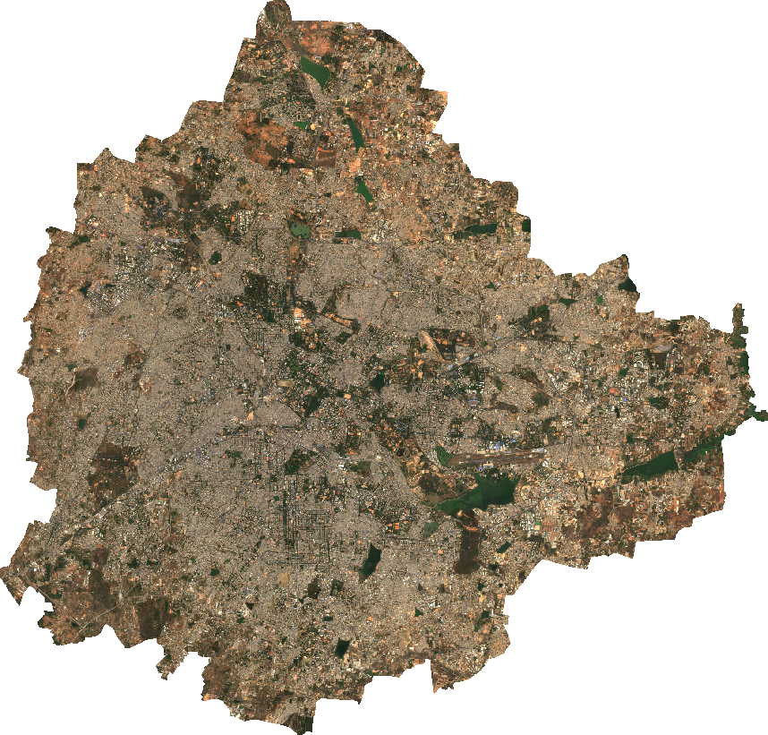

Slide 8
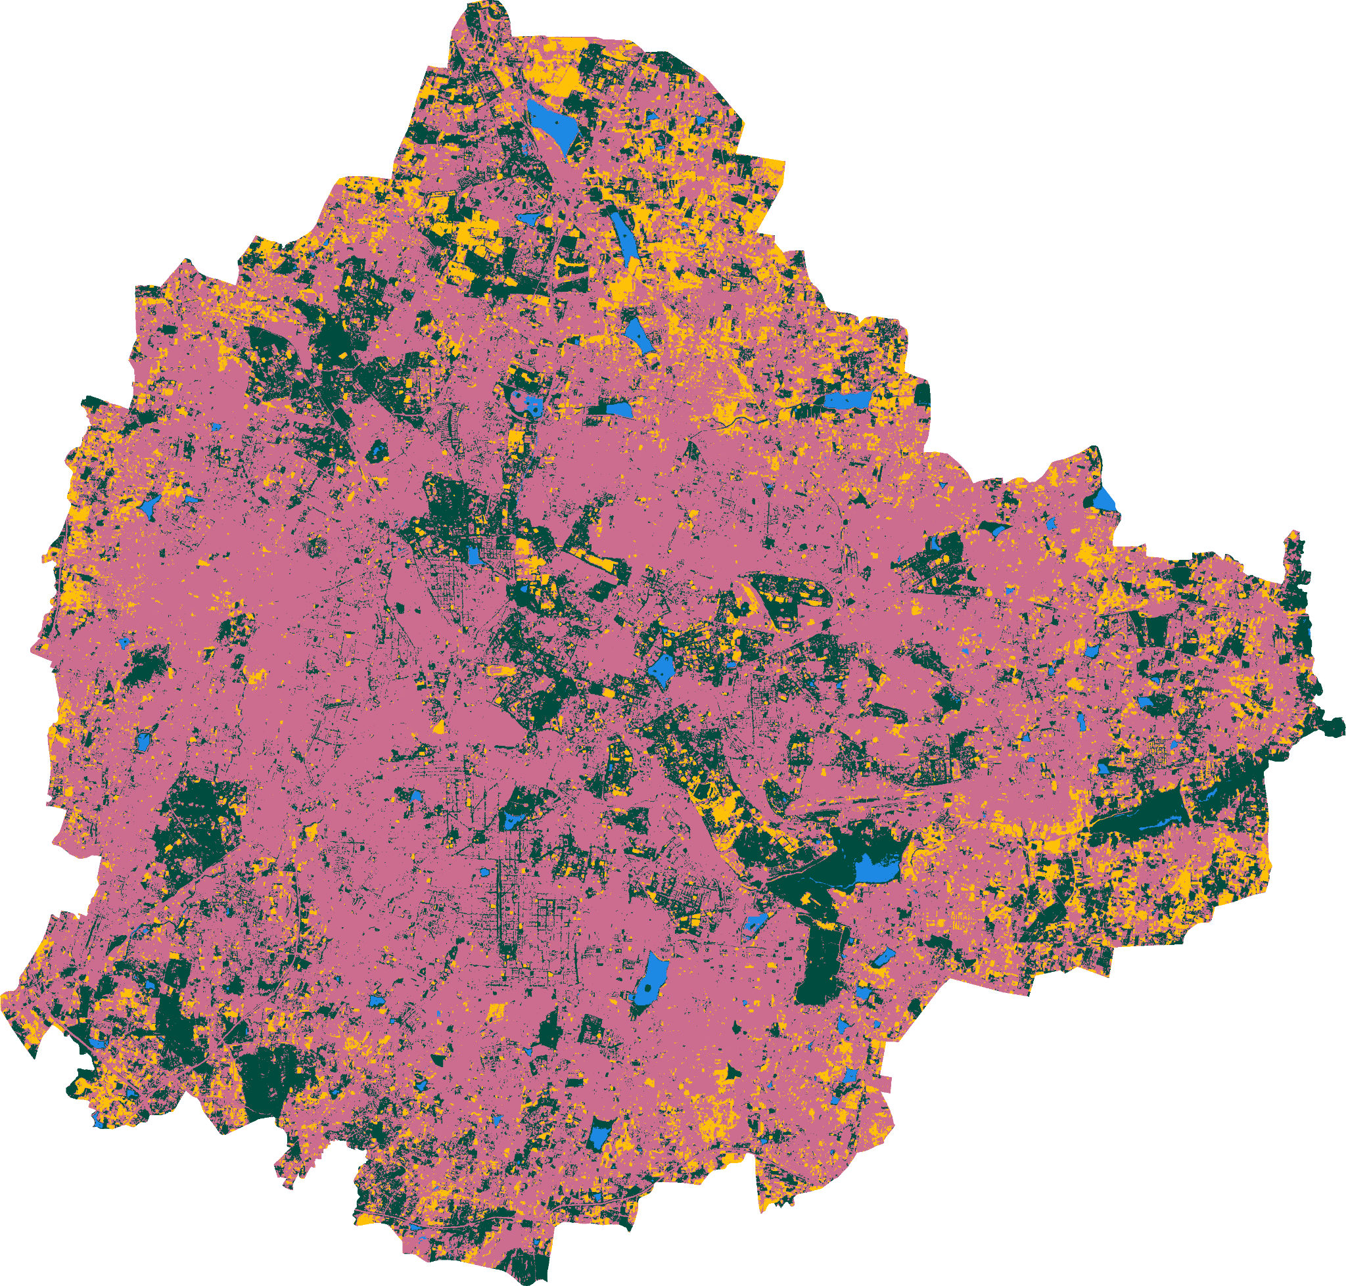
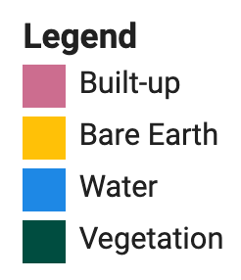

Slide 9
Why do we need to do classification?
For many applications, it is important to know what type of land cover pixel represents. (i.e. water)
For a given land cover, we often need to know about different types of land uses (i.e. agriculture vs. forest)
We also need to quantify land use patterns (i.e. how much agricultural area in a region)
For detecting changes, we need to compare how a pixel changed from Class A to Class B

Slide 10
Example: Water Classification

Slide 11
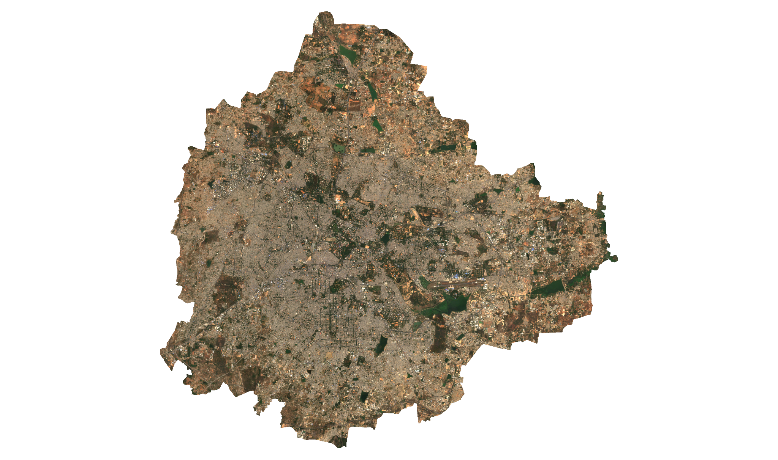

Slide 12
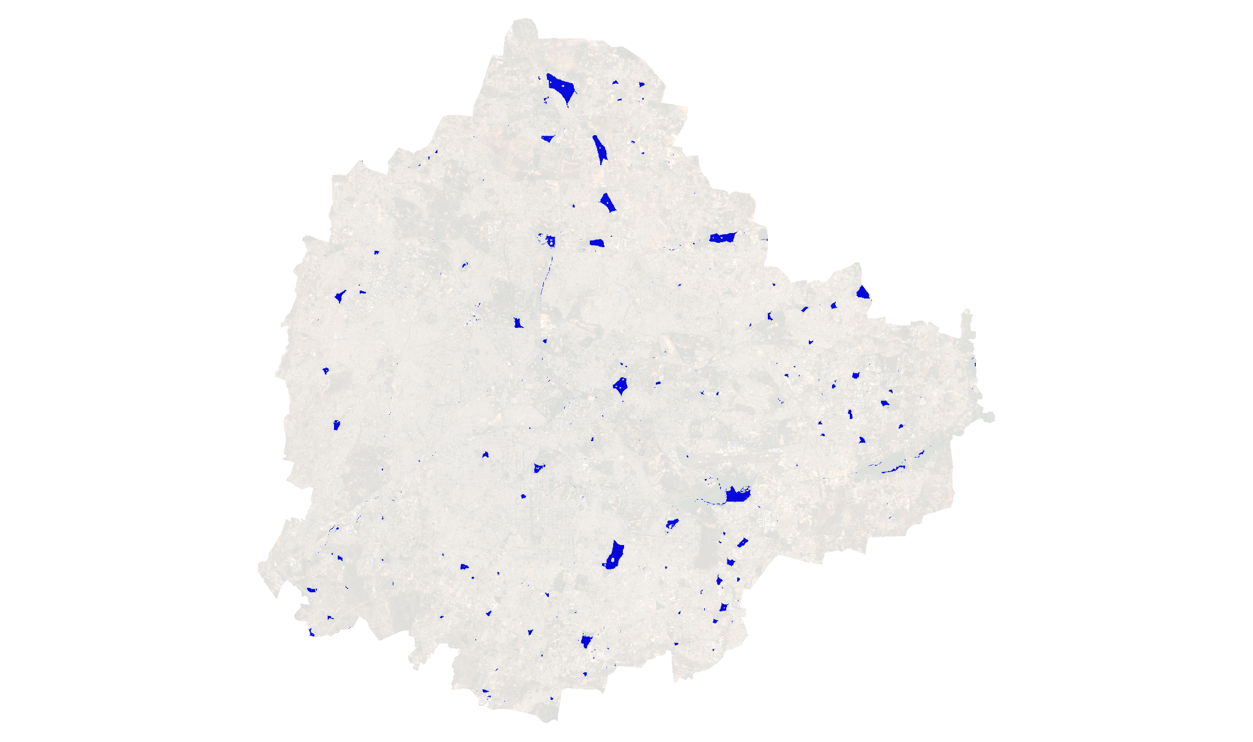

Slide 13


Slide 14
Water Classification
 | Green | NIR
1 | 0.09 | 0.02
2 | 0.2 | 0.34
3 | 0.3 | 0.03
... | ... | ...
... | ... | ...
... | ... | ...
... | ... | ...
100 | 0.01 | 0.10
Water?
Y
N
Y
...
...
...
...
N

Slide 15
Water Classification
Support Vector Machine
Reflectance (NIR Band)
Decision Tree
Neural Network
Reflectance (Green Band)

Slide 16
Support Vector Machines
Splits the data using a linear decision surface (hyperplane)
Ideal for single class classification
Notes:
http://web.mit.edu/6.034/wwwbob/svm-notes-long-08.pdf

Slide 17
Water Classification
Reflectance (NIR Band)
Reflectance (Green Band)

Slide 18
Decision Trees
Ideal for Multi-class problems
Builds a flow-chart like structure where a set of decisions lead to an output class
Most popular machine learning algorithms
Easy to interpret
Simple
Can be used for both classification and regression
Notes:
https://en.wikipedia.org/wiki/Decision_tree_learning

Slide 19
Input
Water Classification
Green < {x}
Green >= {x}
{y}
Not Water
Reflectance (NIR Band)
NIR < {y}
NIR >= {y}
Water
Not Water
{x}
Reflectance (Green Band)

Slide 20
Random Forest
Simple Decision Trees tend to overfit the data
Random Forest algorithm creates multiple decision trees that are trained on slight variations of the training data
The final output is the majority of the individual decision trees
This is called ensemble learning
Notes:
https://builtin.com/data-science/random-forest-algorithm
Bagging Explained: https://towardsdatascience.com/understanding-random-forest-58381e0602d2

Slide 21

Image © Wikipedia
Notes:
https://en.wikipedia.org/wiki/Random_forest

Slide 22
Supervised Classification Workflow
Collect Training Data
Train a Classifier
Classify the Image
Tune Parameters
Classified Image
Input Image
Accuracy Assessment
Post Processing

Slide 23
Tips for Training Data Collection
Always use the image you want to classify as reference when adding a point
Do not concentrate training points on a specific region. Collect training points across different regions of your city
Collect training points on a diverse surface types - different buildings, different types of surface water etc.
Collect points on streets (road surface)
Ctrl + / | Cmd + / for bulk comment

Slide 24
Accuracy Assessment

Slide 25
Accuracy Assessment
Training data (GCPs) are divided into 2 fractions
Training fraction
Validation fraction
Model is trained only with the data from the training fraction
Model’s output is tested with the validation fraction
Output contains the actual value (landcover class) and predicted value (classification)
A confusion matrix is generated between the actual and predicted values
Notes:
http://www.asprs.org/wp-content/uploads/pers/1986journal/mar/1986_mar_397-399.pdf
https://en.wikipedia.org/wiki/Confusion_matrix

Slide 26
Accuracy Metrics
Overall Accuracy
How many samples were classified correctly
Producer’s Accuracy (Recall)
How well did the classification predict each class
Consumer’s Accuracy (Precision/Reliability)
How reliable is the prediction in each class
Kappa Coefficient
How well the classification performed as compared to random assignment
F1-score
Mean of Precision and Recall

Slide 27
Classification (Predicted)
 | 0 | 1 | 2 | 3
0 | 41 | 4 | 0 | 0
1 | 3 | 43 | 0 | 0
2 | 0 | 0 | 48 | 3
3 | 0 | 0 | 0 | 37
0.91
0.93
0.94
1.00
Ground Truth (Actual)
Producer’s Accuracy
0.93 | 0.91 | 1.00 | 0.93
0.94
Consumer’s Accuracy
Overall Accuracy

Slide 28
Advanced Techniques for Geospatial Machine Learning

Slide 29
Modeling Time-Series For Classification
Many types of classification problem require capturing temporal changes
You can capture the time-series variables as bands in your image.
There are 2 main techniques
Seasonal Composites: Create Seasonal Composite images and add them as bands to your image.
Time-Series Modeling: Fit a model to the time-series and add resulting bands to your image
Code in Supplement > Supervised_Classification > Time_Series_Modeling

Slide 30
Capturing Spatial Context
Use ee.Image.pixelLonLat() to add latitude and longitude as input parameters.
Use distance() to create Euclidian Rasters that capture the distance to nearest feature
Use neighborhoodToBands() to add neighbor pixel values as bands and use them as input parameters.
Code in Supplement > Supervised_Classification > Adding_Spatial_Context

Slide 31
References

Slide 32
Classification
Shetty, S.; Gupta, P.K.; Belgiu, M.; Srivastav, S.K. Assessing the Effect of Training Sampling Design on the Performance of Machine Learning Classifiers for Land Cover Mapping Using Multi-Temporal Remote Sensing Data and Google Earth Engine. Remote Sens. 2021, 13, 1433. https://doi.org/10.3390/rs13081433
Kelley, L.C.; Pitcher, L.; Bacon, C. Using Google Earth Engine to Map Complex Shade-Grown Coffee Landscapes in Northern Nicaragua. Remote Sens. 2018, 10, 952. https://doi.org/10.3390/rs10060952
Tassi, A.; Vizzari, M. Object-Oriented LULC Classification in Google Earth Engine Combining SNIC, GLCM, and Machine Learning Algorithms. Remote Sens. 2020, 12, 3776. https://doi.org/10.3390/rs12223776

Slide 33
Composites
Phan, T.N.; Kuch, V.; Lehnert, L.W. Land Cover Classification using Google Earth Engine and Random Forest Classifier—The Role of Image Composition. Remote Sens. 2020, 12, 2411. https://doi.org/10.3390/rs12152411
D. Simonetti, U. Pimple, A. Langner, A. Marelli, Pan-tropical Sentinel-2 cloud-free annual composite datasets, Data in Brief, Volume 39, 2021, 107488, ISSN 2352-3409,https://doi.org/10.1016/j.dib.2021.107488.

